Slide 1
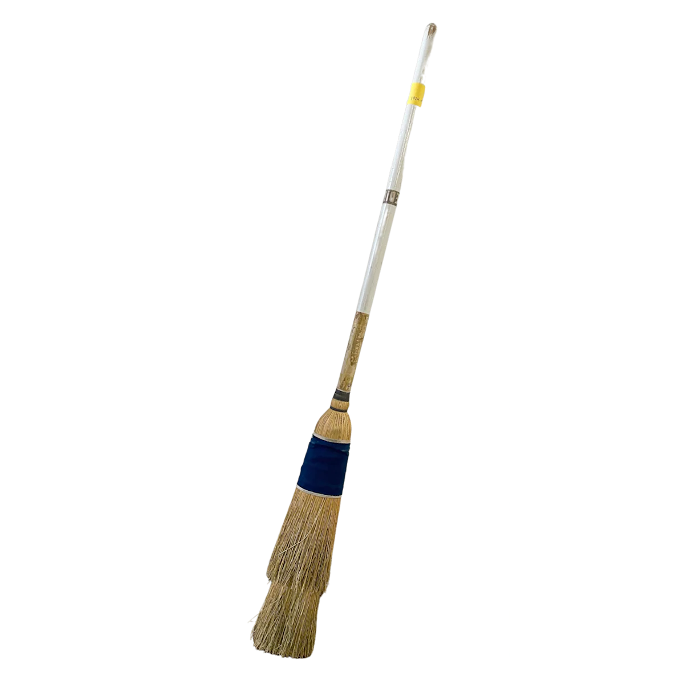

Diamond State Curling Club
10th Anniversary

